Slide 1

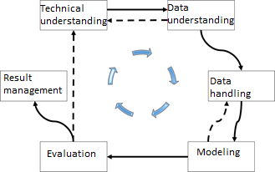
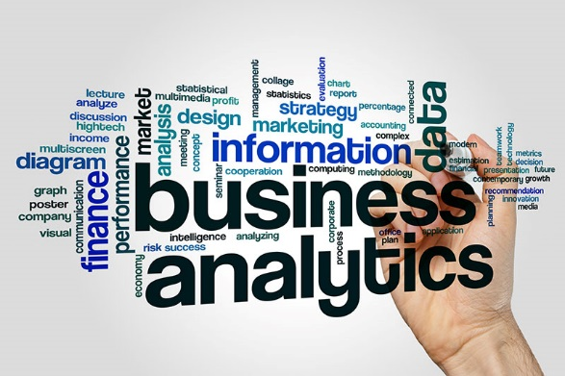
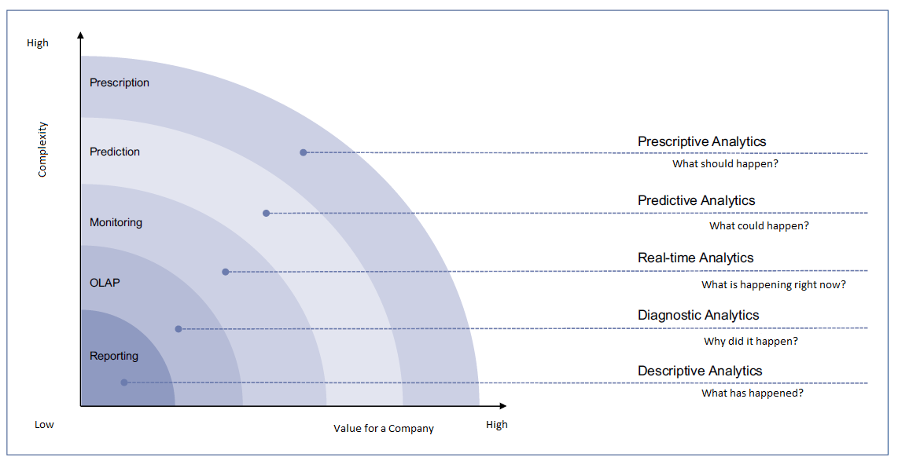
Technique and Procedures of Business Analytics
The basis of all business analytics systems is to run an analysis on existing historical data. Here, the field of application of the analysis is seen as a process, which implies that knowledge is gained from the individual structural properties of the data. What kind of big data analysis method is used varies, differs from application to application. The analysis procedures will be further explained later in the paper. The aim of the field of application of the analysis is to answer questions. \begin{figure*} \centering \includegraphics[width=16cm]{Abbildungen/Analysis.png} \caption{Analysis Questions \cite{2}}\label{visina8} \end{figure*} As you can see in Figure 2, the questions which can be asked and answered each provide a different solution of the Business-Analytic-System. Within the scope of the application areas of business analytics, only descriptive analytics, diagnostic analytics and real-time analytics are used. The descriptive analytics follow the classic concept reporting, which analyses the situation in terms of what has happened and when did it happen. Diagnostic analytics follows the investigative approach. The main question here is why this situation could have arisen. The last shown possibility of the application field of analysis corresponds to the principle of real-time analytics. These are based on monitoring systems which are currently in running in a system.
2nd International Students’ Conference Minden 2018 on
New Developments in Data Science and Big Data Analytics
Sean Payne– Fachhochschule Bielefeld
Introduction
General Information
Workflow in a Nutshell
In the past, it was the job of a so-called controller to check and juggle the economic figures of a company to gather information about its economic efficiency. But nowadays this has changed. The task area of a controller has become much more technically adept and complex in the last decades. Nowadays, one of the main tasks of a controller is to apply so-called "business analytics" in order to keep the company economically, so that it can still be represented on the market. But what exactly are these business analytics? In order to provide a better overview of business analytics, does this poster provides information on the general clues that should be considered when implementing a business analytics system.
What are Business Analytics?
Business Analytics describes the procedure and the processes for the systematic analysis of your own company. This includes the collection, evaluation and presentation of data in electronic form (cf. [1]).
What is the aim of Business Analytics?
The aim is to gain insights that support operational and, above all, strategic decisions focused on corporate goals. The evaluation of data - about one's own company, competitors or market developments - is carried out with the aid of analytical concepts and more or less specialized software and IT systems. With the insights gained, the company can make its business processes as well as its customer and supplier relationships more successful; aspects here can be cost reduction, risk reduction and value creation (cf. [1]).
What should be considered if you intend to use Business Analytics?
One thing which should be considered is that it is important to figure out what kind of business analytics system you want to use. This can be done by asking yourself the question of what you want to analyze. This topic will be discussed in the section of “Application Areas”.
The next thing to focus on is the technology. Does the already possessed technology, support the type of business analytics model, which you want to introduce?
Or is it necessary to invest in a completely new hard- and software solution? Another important thing to consider is the personnel, which will be using the business analytics system. The staff should be able to use the system correctly and make the right amount of changes so that the business analytics system is maintained in the future. The last point of consideration should be the time. The last point is time. A good business analytics system needs time to evaluate data and create empirical values.It should not be assumed that a business analytics system implemented today can already deliver solutions of any kind tomorrow.
These four points should definitely be taken into account in the planning. If this is not the case, even the best business analytics system will not be able to fulfil a meaningful purpose.
As already mentioned in the introduction, should business analytics be seen as a tool of the controlling, which might help the controller and/or managers of a company, to lead the company to a new course. The general process of business analytics is to be seen as an ongoing, continuous process and is described in Figure 2.
Technical understanding:
The point of entrance into business analytics, should be the process of technical understanding. This workflow consists of gathering information and knowledge about the application area, where the company wants to run this analytics (cf. [7]).
Data understanding:
The process of data understanding is the one that is based on the results of the technical understanding process. This is where the user is starting to understand what kind of data he needs for the upcoming analytics. It is possible that the process of data understanding is providing new information for the technical understanding (cf. [7]).
Data handling:
The data handling process describes the search for relevant or useful data or the sorting out of superfluous data (cf. [7]).
Modeling:
The modeling process includes the preparation of the data obtained in the previous process. These data are then fed into the analyses. However, if the data does not correspond to these needed for the analysis, it is redirected to the data handling process so that they can be adjusted again (cf. [7]).
Evaluation:
After the modeling process has been completed and the analyses has been run, the results are now ready to be viewed and evaluated. It might happen that the results of the analysis does not have any information about the direction, which the company should steer to. In that case is it important that the person who evaluates the results does still save these results since it might be smart or useful to use these information for further studies. The person who is in charge of the business analysis will always gather an amount of technical understanding of each and every analysis (cf. [7]).
Result management:
If the evaluation process delivers any useful results, they are then delivered into the result management process. This process describes the way the results of the evaluation are being handled and new company strategies can be executed (cf. [7]).
Figure 2 : Business Analytics Process [3]
Figure 1: small symbolistic [2]
application Areas
References
The basis of all business analytics systems is to run an analysis on existing historical data. Here, the field of application of the analysis is seen as a process, which implies that knowledge is gained from the individual structural properties of the data. What kind of big data analysis method is used, varies from application to application. The analysis procedures will be further explained later in the paper. The aim of the field of application of the analysis is to answer questions.
Analysis:
As you can see in Figure ?, the questions which can be asked and answered each provide a different solution of the Business-Analytic-System. Within the scope of the application areas, only descriptive analytics, diagnostic analytics and real-time analytics are used. The descriptive analytics follow the classic concept of reporting, which analyses the situation in terms of what has happened and when did it happen. Diagnostic analytics follows the investigative approach. The main question here is why this situation could have arisen. The last shown possibility of the application field of analysis corresponds to the principle of real-time analytics (cf. [4]).
These are based on monitoring systems which are currently in running in a system (cf. [4]).
Forecast:
Forecasting is a business analytics tool that uses stochastic models, machine learning and data mining approaches to make efficient forecasts with good results. There is an additional distinction to the so-called digital forecasts as well. The digital forecasts can be used in such a way that at the end, for example, by combining several of these digital forecasts, to forecast the so-called EBITDA (earnings before interest, taxes, depreciation and amortization). The result is a continuously learning sales forecast, which could be used for the application area of the optimization (cf. [4]).
Optimization:
Another important application area is the optimization. The optimization procedure follows the forecasting procedure.
A very good example of optimization is to optimize the inventory in the retail trade. There the system is automatically adjusted so that, when a customer orders an article, it is automatically offset from the stock quantity of in the warehouse.
As soon as a predefined minimum is reached, this article is going to be reordered automatically by the system.
The optimization model is able to reduce the costs of the company resources by evaluating the results of the forecasts and using the gathered information to identify new cause-effect relationships (cf. [4]).
Simulation:
The simulation process describes the simulation of a company and possible future developments. If simulations are properly designed and fed with all relevant data, they could be used to support operational decisions.
For this type of simulation, there are driver-based models, such as the revenue control model. The aim of the revenue management model is to ensure, that the available resources of all kinds generate the highest revenue. In the best case, the business analytics forecast is the basis of this model. All relevant data, such as capacity, prices, load, operating time, etc., are loaded into the revenue control model. The results of this simulation are, for example, optimized prices at certain selling points (cf. [4]).
Radar:
The radar method is the continuous observation and analysis of the market segment in which the company operates. This is where the term competitive intelligence is used. Competitive intelligence combines processes and technologies for clarifying the market and its associated components, such as customers, suppliers, competitors, etc. This information is analyzed using semantic analyses like natural language processing NLP or text mining. This might help a company to make its own brand more competitive (cf. [4]).
[1]: N. Dedić, C. Stanier: Measuring the Success of Changes to Existing Business Intelligence Solutions to Improve Business Intelligence Reporting. In: Lecture Notes in Business Information Processing. Band 268. Springer International Publishing, 2016, S. 225–236.
[2] https://businesspartnermagazine.com/wp-content/uploads/2017/12/Business-Analytics-Challenges-Faced-by-Small-Businesses.jpg called on 15.07.2018 at 11:47 AM CEST
[3] http://www.enzyklopaedie-der-wirtschaftsinformatik.de/lexikon/daten-wissen/Business-Intelligence/Analytische-Informationssysteme--Methoden-der-/Business-Analytics/index.html/?searchterm=BA called on 14.07.2018 at 1:17 PM CEST
[4] Mehenna et al. 2016: Business Analytics im Controlling – Fünf Anwendungsfelder
[5] https://www.gartner.com/it-glossary/business-intelligence-bi/ Called on 16.06.2018 at 3:28 PM CEST
[6] https://barc.de/news/business-intelligence-fur-alle-bleibt-zukunftsmusik called on 15.07.2018 at 12:56 AM CEST
[7] Dr. Henning Baars 2016: Predictive Analytics in der IT-basierten Entscheidungsunterstützung – methodische, architektonische und organisatorische Konsequenzen
Figure 3: Questions for the business analytics system

